Slide 1

Transfer Learning
Image Classification using Transfer Learning with VGG16 pre-trained model
Veera Raghunatha Reddy Naguru - 22028322

Slide 2
Contents
Dataset introduction
Transfer Learning
Pre-Trained Model
Fine-Tuning
Scratch Model
Transfer Learning Vs. Scratch Model
Limitations

Slide 3
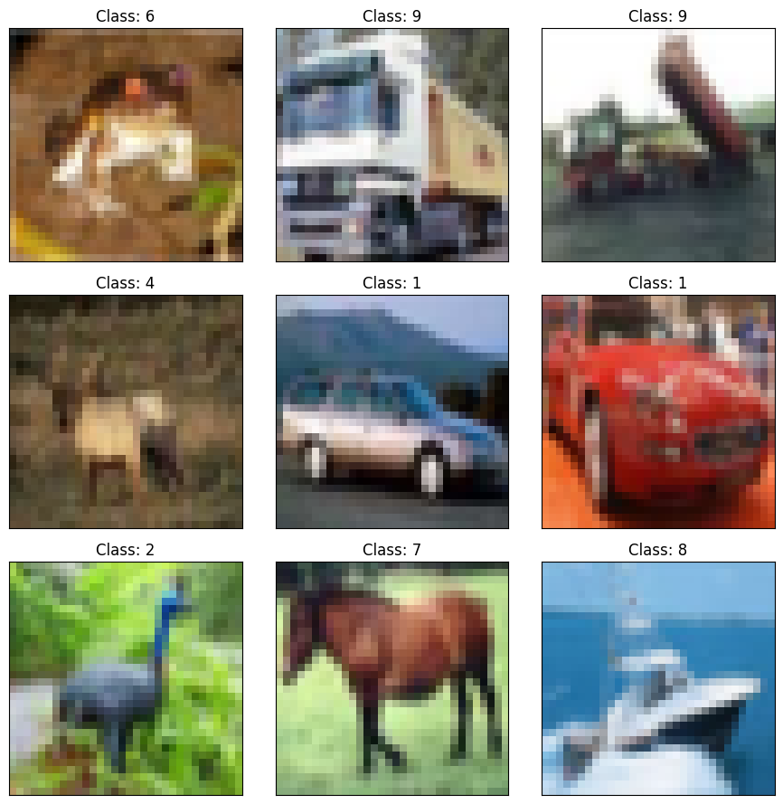
Dataset
I chose CIFAR-10 as my dataset.
This dataset contains 60,000 32x32 colour images which are separated into 50,000 training images and 10,000 testing images of 10 different classes and each class have 5000 training images and 1000 testing images.
These 10 image classes are airplane, automobile, bird, cat, deer, dog, frog, horse, ship and truck.

Slide 4
Transfer Learning
Transfer Learning is a method of using knowledge or features learned by a pre-trained model on new tasks or datasets without the need of building a model from scratch.
Transfer Learning becomes very handy when we are trying to solve a problem with a new dataset, and we can choose pre-trained model which are trained on same problem.
Transfer Learning saves time and effort by providing pre-trained models which avoids the usage of high performance of GPU’s again while building the model from scratch.

Slide 5
Pre-Trained Model
I chose VGG16 application for this Transfer Learning task, as my dataset requires image classification.
VGG16 is a 16 layers deep convolution neural network.
VGG16 had been trained over a million images and is able to classify images up to 1000 object classes.
VGG16 is also a complex model which takes significant computational resources for training.
Due to its pre-trained learning over huge data, I chose to use this model on my chosen dataset via Transfer Learning for classifying 10 object classes of my dataset.

Slide 6
Fine Tuning
I built layers on top of the layers on the pre-trained model to fit my dataset.
I froze all the trainable layers of the pre-trained model and trained the model, and the accuracy was around 0.49 with freeze layers.
I unfroze all the trainable layers of the pre-trained model and trained the model, and the accuracy jumped up about 0.82.
On top of these, I created callbacks and learning rate scheduler to increase the model accuracy and the maximum accuracy achieved is 0.85.
To fine tune the model, I pre-processed data and used data augmentation, but the accuracy went down to 0.6, so for this dataset and model data augmentation is not recommended.

Slide 7
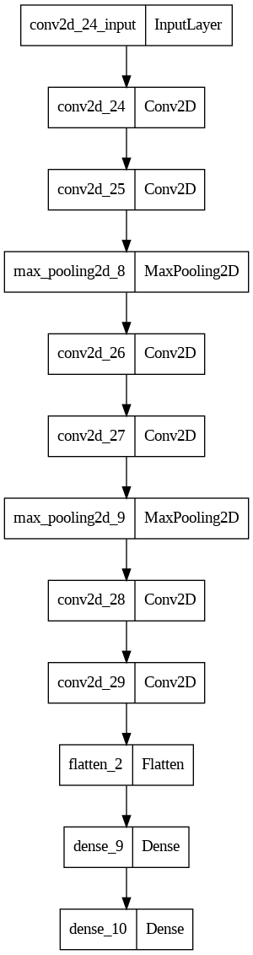
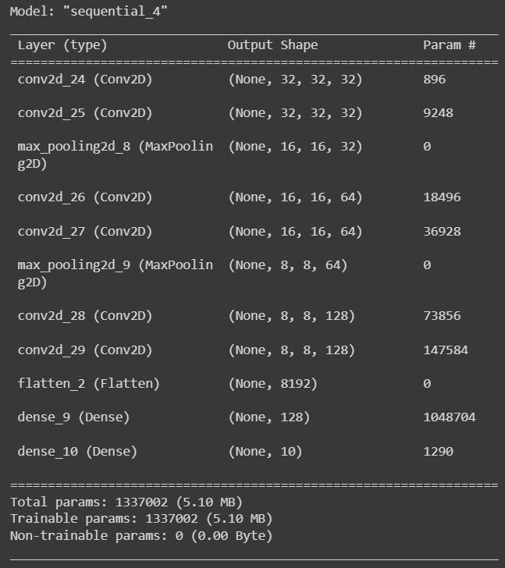
Scratch Model
Created a convolution model to satisfy my image classification task and the model plot is shown.
The scratch model summary can be seen.
The scratch model has a total of 1337002 parameters.
The scratch model gave an accuracy of 0.669.

Slide 8
Transfer Learning Vs. Scratch Model
Class | Precision | Recall | F1-Score
0 | 0.85 | 0.91 | 0.88
1 | 0.91 | 0.93 | 0.92
2 | 0.83 | 0.81 | 0.82
3 | 0.72 | 0.67 | 0.69
4 | 0.85 | 0.81 | 0.83
5 | 0.78 | 0.79 | 0.78
6 | 0.87 | 0.91 | 0.89
7 | 0.84 | 0.91 | 0.87
8 | 0.95 | 0.90 | 0.92
9 | 0.91 | 0.87 | 0.89
Class | Precision | Recall | F1-Score
0 | 0.72 | 0.73 | 0.72
1 | 0.80 | 0.75 | 0.77
2 | 0.59 | 0.50 | 0.54
3 | 0.51 | 0.47 | 0.49
4 | 0.54 | 0.69 | 0.61
5 | 0.62 | 0.54 | 0.58
6 | 0.66 | 0.80 | 0.73
7 | 0.78 | 0.66 | 0.71
8 | 0.77 | 0.81 | 0.79
9 | 0.73 | 0.73
The Transfer Learning Model performed well when compared.

Slide 9
Limitations and Areas of Improvement
The pre-trained model takes huge computational resources and to attain high accuracy we need to run more epoch which leads to increase computation costs.
The scratch model didn’t give expected accuracy, yet the computational resources used is very less.
The selection of pre-trained models must be done with good knowledge of what type of data they were trained on, else getting accuracy on new dataset is quite challenging.
While fine tuning, instead of making all layers trainable, we can try and see how the model performs with only half or few of the layers are trainable.

Slide 10
References
Srikanth Tammina (2019); Transfer learning using VGG-16 with Deep Convolutional Neural Network for Classifying Images; International Journal of Scientific and Research Publications (IJSRP) 9(10) (ISSN: 2250-3153), DOI: http://dx.doi.org/10.29322/IJSRP.9.10.2019.p9420

